Slide 1


Identifying Reimbursement Opportunities for Healthcare Providers and Professionals
Mark Roach
Rishabh Sareen
Alexander Sietsema
Siqiang Wang
April 28, 2022
Work done in partial fulfilment of the requirements of Michigan State University MTH 844; advised by Mr. Jesse Parker, Mr. Rick Reid, and Ms. Brooke Yowell, The Rybar Group; Dr. David Bramer and Dr. Peiru Wu, Michigan State University.

Slide 2

Outline
Objectives
Data
Analysis
Methods
Results and Discussion
Conclusions
Recommendations
Acknowledgements

Slide 3
Objectives
Create a Graphical User Interface (GUI) that can collect and summarize raw data.
Describe the variation of Disproportionate Share Hospital (DSH) patient percentage for rural and urban hospitals and across different states.
Assist The Rybar Group in identifying reimbursement opportunities for hospitals around the 15% DSH patient percentage threshold.
Analyze trends in DSH patient percentage over time using predictive modeling.

Slide 4
Medicare and Medicaid
Centers for Medicare & Medicaid Services (CMS) is a federal agency that runs the Medicare, Medicaid, and Children's Health Insurance Programs.
Medicare: Federal program that provides health coverage if you are 65+ or under 65 and have a disability.
Medicaid: State and federal program that provides health coverage if you have a very low income.
Medicare-certified institutional providers are required to submit an annual cost report to CMS.

Slide 5
Describing the Cost Report
Cost reports from the 2010 to 2020 fiscal years were provided.
The report table contains information such as the provider number, fiscal years and the location of the hospital.
The numeric and alpha-numeric tables contain the raw data extracted from the cost reports.
Table 1. Sample column names and description.
Column Name | Description | Example
ADR_VNDR_CD | Vendor for Fiscal Intermediary | 4
ALPHNMRC_ITM_TXT | Provider reported alpha data | 2600DRUGS
CLMN_NUM | Valid Column Number defined | 1000
FI_CREAT_DT | Date the FI created the HCRIS file | 7/15/2021
FI_NUM | Fiscal Intermediary Number in effect at the time of cost report filing | 11001
FI_RCPT_DT | Date cost report was received by Fiscal Intermediary | 7/14/2021
FY_BGN_DT | Cost Report Fiscal Year beginning date | 1/1/2020
FY_END_DT | Cost Report Fiscal Year ending date | 12/31/2020
INITL_RPT_SW | Y or N, Y = the first cost report filed for this provider | N

Slide 6
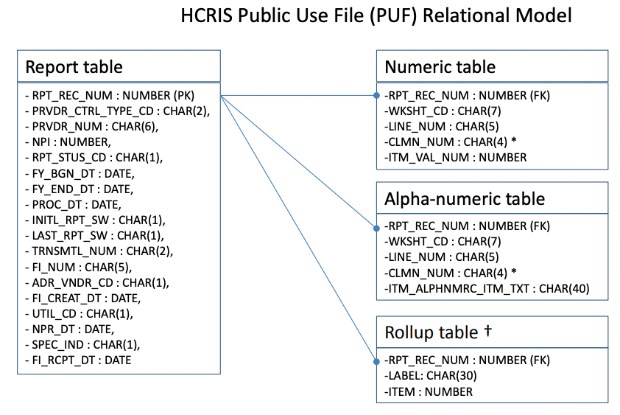
Unpacking the Data
Table 2. Column names and types for each raw data table.
In total, there are 27 columns of data across the four tables.
The data tables contain all the information extracted from the cost reports such as provider information, costs and charges for fiscal year, etc.
There are around 3 million rows of data in the alpha table and 19 million rows of data in the numeric table.

Slide 7
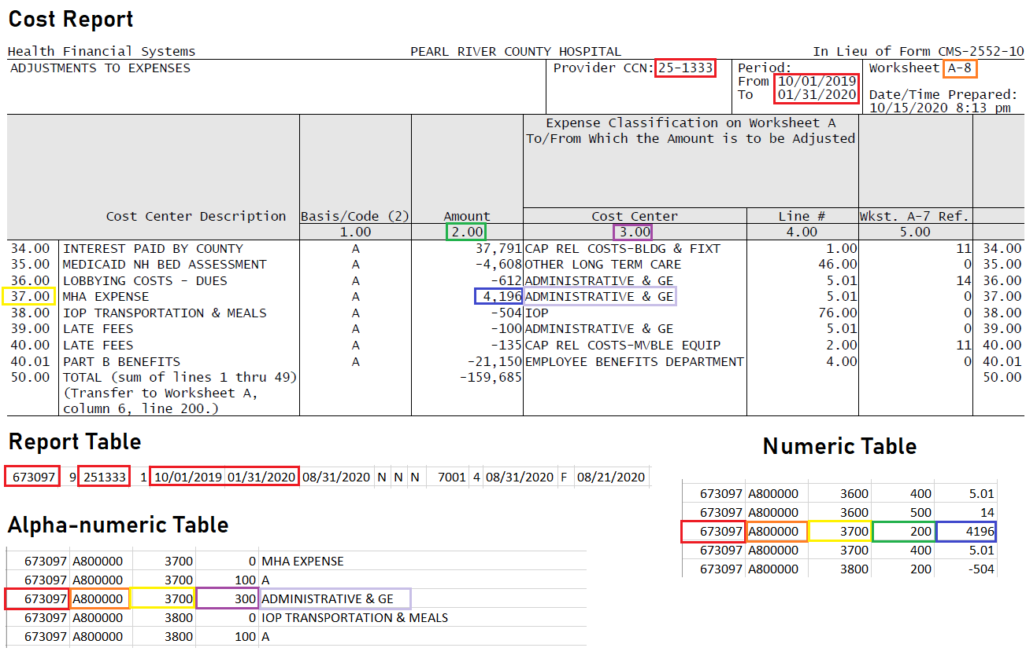
Correlating Data with Cost Report
Table 3 shows the relationship between the fields of a cost report and the corresponding raw data.
The report number is shared between all four of the raw data tables.
Table 3. A sample cost report compared to the raw data tables.

Slide 8
Locating Fields in the Cost Report
The worksheet code refers to a particular section of the cost report.
The line and column numbers refer to specific rows and columns for that worksheet in the report.
The numeric table contains numeric fields, while the alphanumeric table contains text fields.
Table 3. A sample cost report compared to the raw data tables.

Slide 9
Medicaid Utilization
The ratio between its total Medicaid Patient Days and Total Patient Days.
Total Medicaid Patient Days:
Total Patient Days:
Table 4. Breakdown of the total Medicaid patient days.
Table 5. Breakdown of the total patient days.

Slide 10
Supplemental Security Income
Medicare Supplemental Security Income (SSI) percentage is one of the metrics used to calculate DSH reimbursements.
The SSI percentage is the ratio between the total Medicare SSI days and the Total Patient Days in Part A.
The SSI is a federal cash assistance program for Americans who are 65 or older, blind or disabled, and have low incomes and resources.

Slide 11
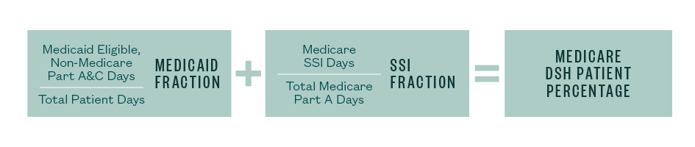
Calculating DSH Percentage
Figure 1. Breakdown of DSH patient percentage.
The Medicaid Fraction consists of Medicaid eligible patient days that are not entitled to Medicare, divided by all total inpatient days.
The SSI Fraction consists of Medicare days where patients also have federal SSI benefits, divided by the total hospital Medicare patient days.

Slide 12
Cost-to-Charge Ratio
The ratio between a hospital’s expenses and how much a hospital charges to the patients.
Estimates the cost of procedures between different hospitals.
Table 6 shows how cost-to-charge ratios can differ between hospitals.
Table 6. Comparison of cost-to-charge ratio for Hospitals A and B.
.
 | Hospital A | Hospital B
Number of Knee Replacements per month | 20 | 10
Total Charges | $800,000 | $500,000
Average Charge Per procedure | $40,000 | $50,000
Hospital Cost to Charge Ratio | 40% | 35%
Estimated Cost Per Procedure | $20,000 | $17,500

Slide 13
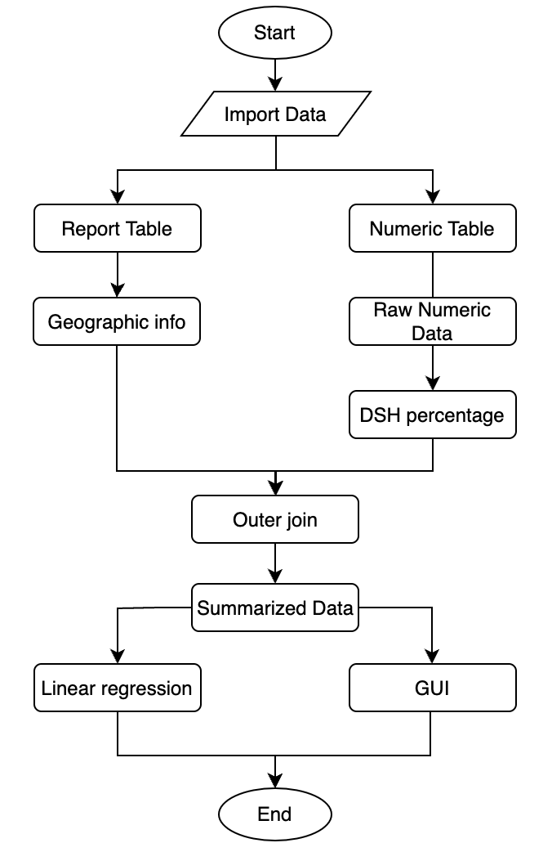
Workflow Chart
Specific data fields were extracted from the report and numeric tables.
Extracted fields were used to generate new metrics like the DSH percentage.
A GUI was also built to open, read, join, and summarize the data automatically.
Figure 2. Workflow chart of data manipulation.

Slide 14
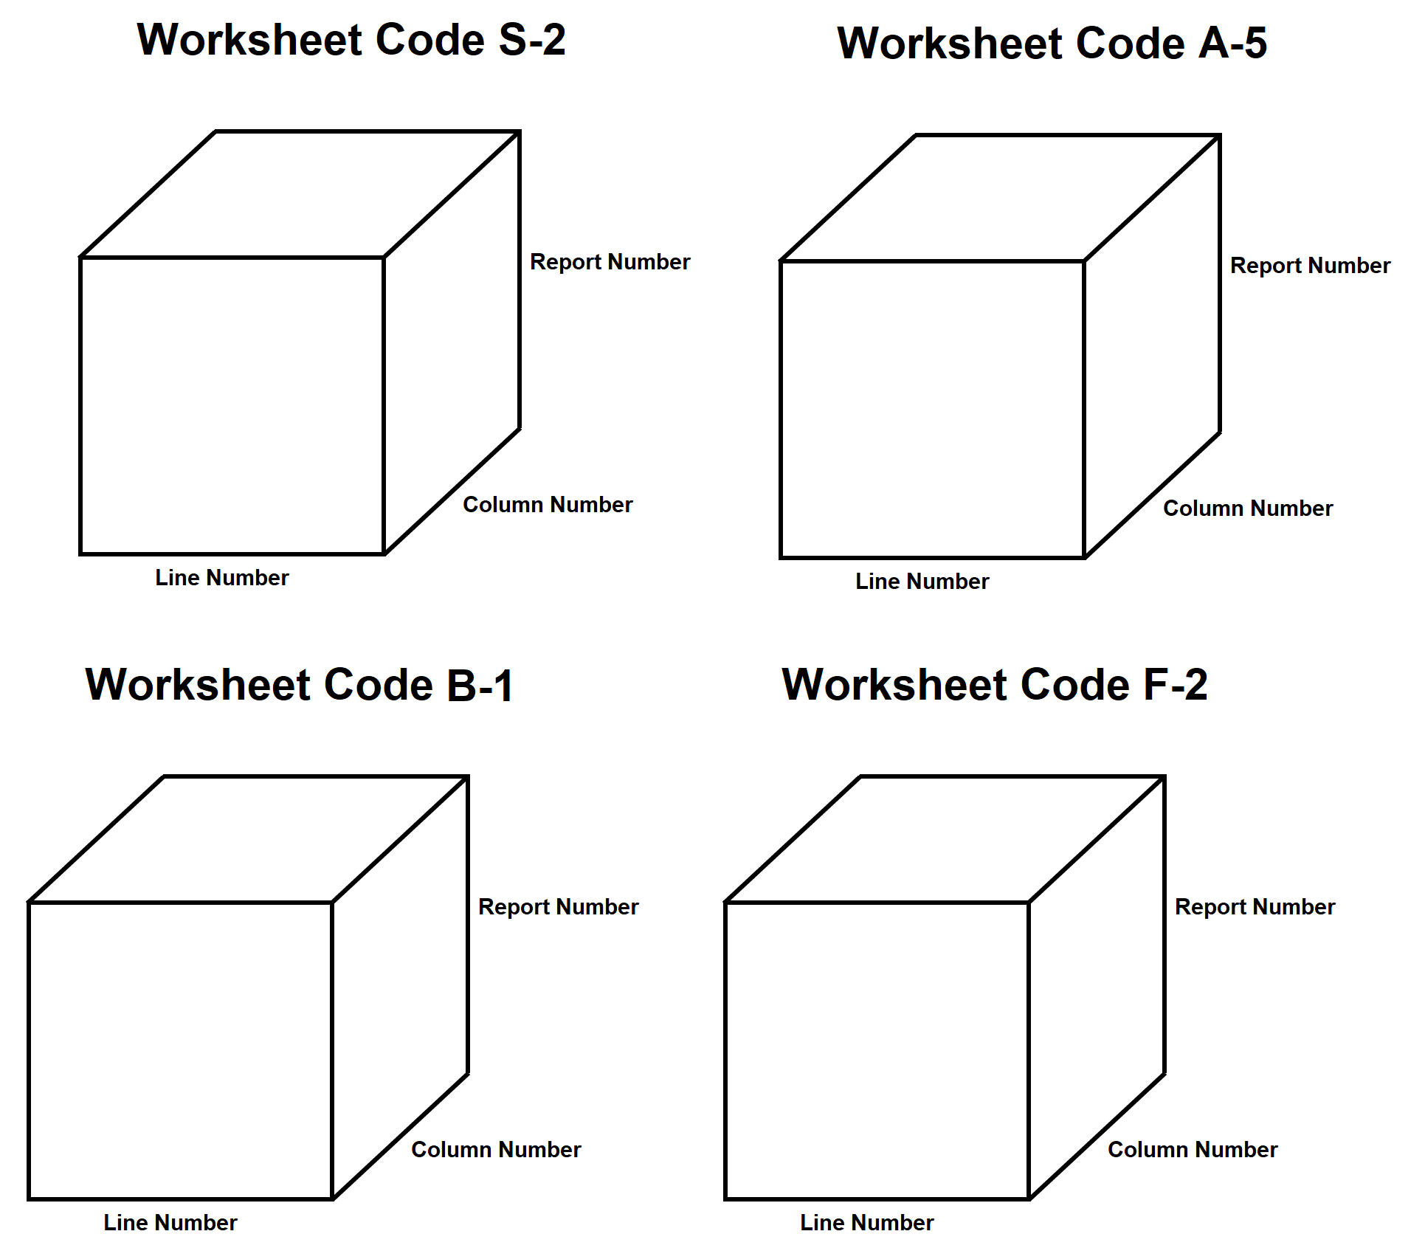
Indexing the Data
Each raw table was divided into separate worksheets.
The separated worksheets were indexed by report number, row number, and column number.
Figure 3. Figurative diagram of data storage.

Slide 15
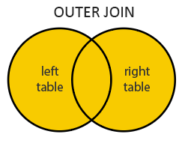
Outer Join
The desired fields were extracted from each worksheet and combined into a summarized table.
Outer join return all of the records that have values in either the left or right table.
Figure 4. Venn diagram of Outer Join.

Slide 16
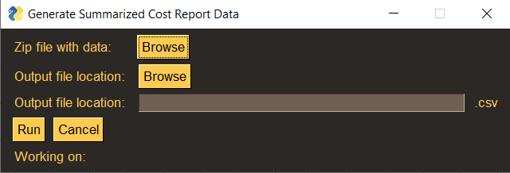
Graphical User Interface
A GUI was developed to provide a file containing summarized data.
Input: Raw data (zip file) location.
Output: Summarized data (CSV file).
Figure 5. Graphical User Interface Window.

Slide 17
Initial DSH Percentage Calculation
The Medicaid Utilization and SSI Percentage were computed for each provider.
Those fields were totaled to find the associated DSH patient percentage.
The raw data contained only 23% valid numerical responses.
Table 7. Initial DSH Patient Percentage Calculation.
RPT_REC_NUM | HMO | TOT_HOSP | LAB_DEL_DAYS | TOT_HOSP | MED_UTIL | SSI_PER | DSH_PAT_PER
649071 | nan | nan | nan | 481 | nan | 0.1529 | nan
649407 | 1056 | 2965 | 50 | 31535 | 0.1291 | 0.0268 | 0.1559
649741 | 854 | nan | 18 | 6287 | 0.1387 | 0.0434 | 0.1821
650373 | 18 | 46 | 7 | 707 | 0.1004 | 0.0465 | 0.1469
650435 | nan | nan | nan | 9738 | nan | 0.0942 | nan
650477 | 262 | nan | 10 | 1701 | 0.1599 | 0.0765 | 0.2364
650826 | 180 | nan | 2 | 1129 | 0.1612 | nan | nan
651192 | 557 | 1434 | 22 | 1329 | 0.1514 | 0.0209 | 0.1723
651366 | nan | nan | nan | 137 | nan | nan | nan

Slide 18
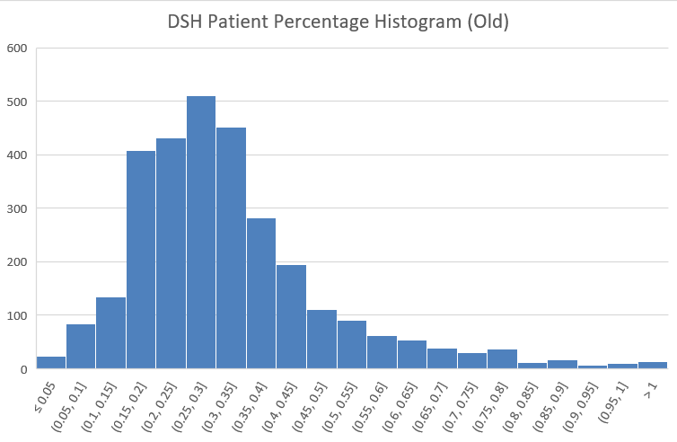
Initial DSH Histogram
The histogram of DSH Patient Percentages is skewed right.
The histogram ignores all providers with missing data.
Figure 7. Initial DSH Patient Percentage Histogram.

Slide 19
Corrected DSH Percentage Calculation
The 'nan' values refer to instances in the cost report where no value was given by the provider.
After consultation with Rybar Group, missing values were set to 0.
This gives a more accurate set of DSH patient percentages.
Table 8. Corrected DSH Patient Percentage Calculation.
RPT_REC_NUM | HMO | TOT_HOSP | LAB_DEL_DAYS | TOT_HOSP | MED_UTIL | SSI_PER | DSH_PAT_PER
649071 | 0 | 0 | 0 | 481 | 0 | 0.1529 | 0
649407 | 1056 | 2965 | 50 | 31535 | 0.1291 | 0.0268 | 0.1559
649741 | 854 | 0 | 18 | 6287 | 0.1387 | 0.0434 | 0.1821
650373 | 18 | 46 | 7 | 707 | 0.1004 | 0.0465 | 0.1469
650435 | 0 | 0 | 0 | 9738 | 0 | 0.0942 | 0
650477 | 262 | 0 | 10 | 1701 | 0.1599 | 0.0765 | 0.2364
650826 | 180 | 0 | 2 | 1129 | 0.1612 | 0 | 0
651192 | 557 | 1434 | 22 | 1329 | 0.1514 | 0.0209 | 0.1723
651366 | 0 | 0 | 0 | 137 | 0 | 0 | 0

Slide 20
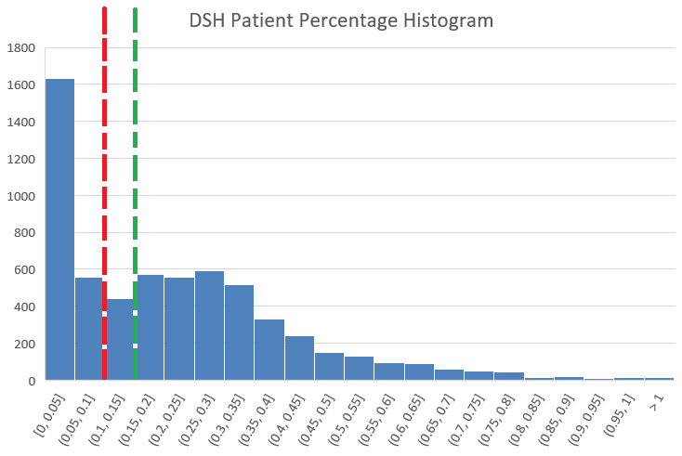
DSH Patient Percentage Histogram
Medicaid Utilization and SSI percentage were computed for all hospitals in 2019.
DSH patient percentage above 15% is eligible for reimbursement.
If DSH percentage is close to 15%, Rybar consults with provider to claim reimbursement.
10%
15%
Figure 8. DSH Patient Percentage Histogram.

Slide 21
DSH Patient Percentage Trends
Figure 9 shows a significant increase over the ten-year period studied.
Increased federal funding available for Medicaid.
Upward trend due to aging of baby boom population enrolled in Medicare.
In 2017, the value reached the highest point.
Figure 9. Average DSH patient percentage from 2010-2020.

Slide 22

Regression Model on DSH Percentage
Model: $\hat{y}=0.0022597x−4.3029$.
The input: for DSH percentage is range from 2010 to 2020.
The model predicts 2021 average DSH percentage to be 26.4%.
The $R^{2}$ coefficient is 0.75, which means that the regression line explains about 75% of the variation of the DSH percentage.
Figure 6. Scatter plot and regression line of DSH percentage.
22

Slide 23
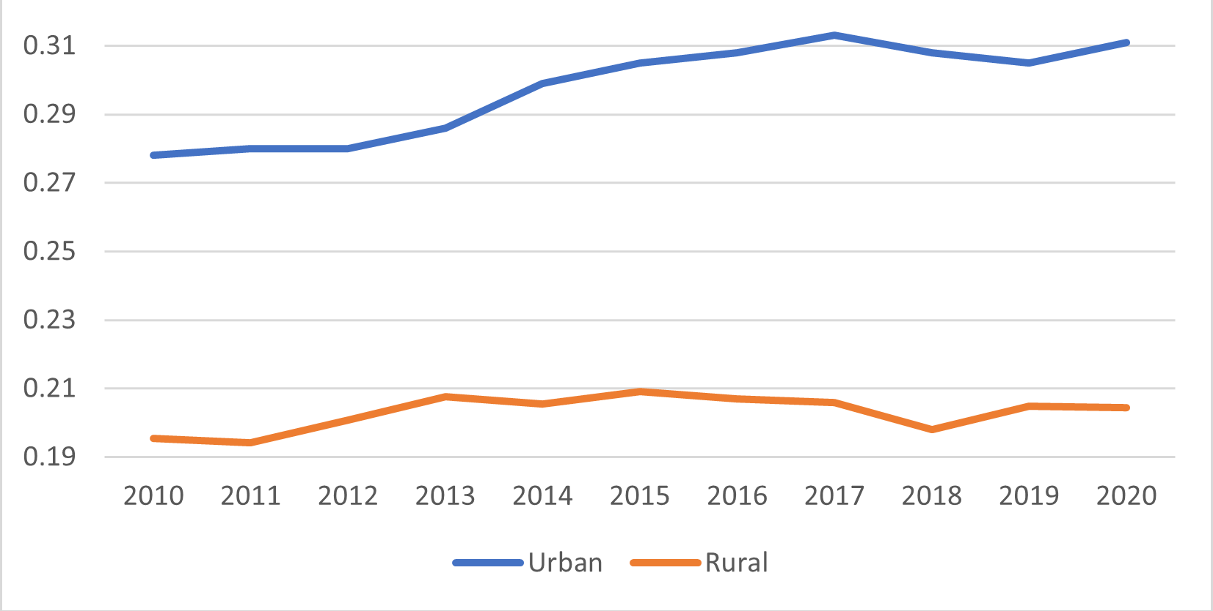
DSH: Urban vs. Rural Hospitals
The DSH percentage of rural hospitals have a higher variation than that of urban areas.
The Medicare Prescription Drug, Improvement and Modernization Act (MMA) passed in 2003 sought to address the issue.
The MMA created an inequity by applying a cap differently based on urban-rural status.
Figure 10. DSH Percentage of Urban vs. Rural hospitals.

Slide 24
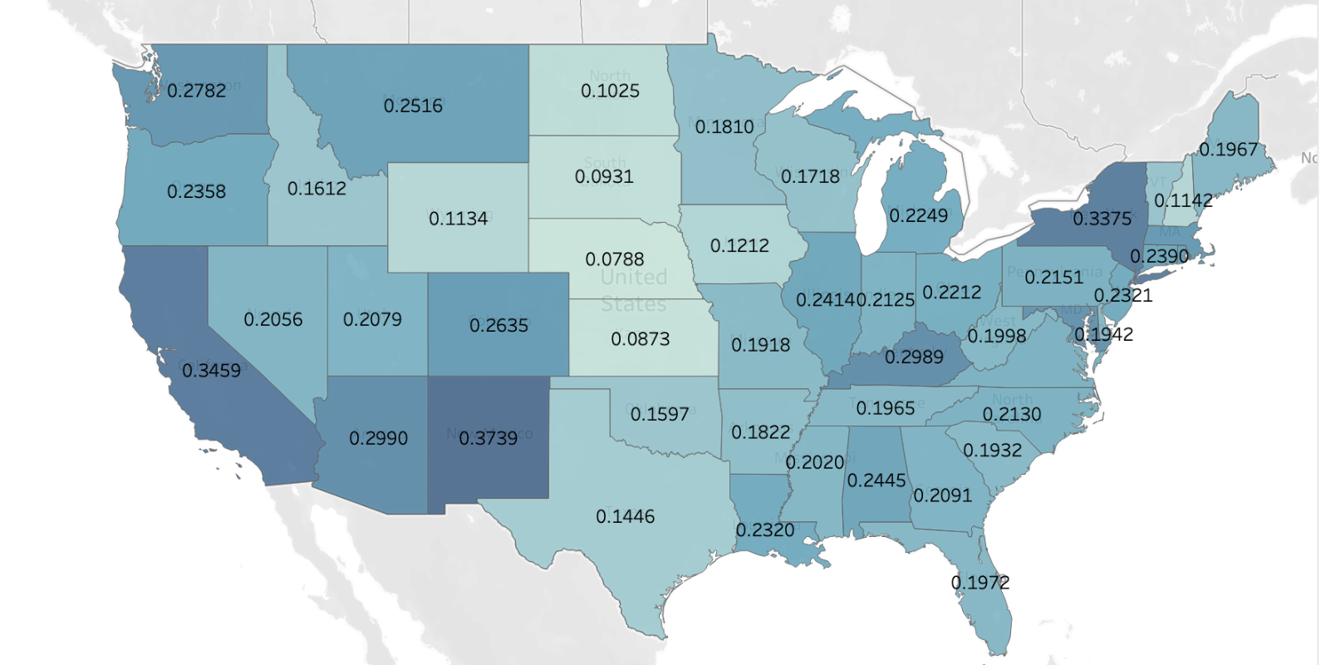
DSH Percentage by State
DSH patient percentages tend to be lower in the central states.
New Mexico has the highest average (e.g. 0.3739).
Nebraska has the lowest average (e.g. 0.0788).
Figure 11. Average Percentages by State in 2019.

Slide 25
Medicaid Expansion
Under the Affordable Care Act (ACA) passed in 2010, states were required by law to expand Medicaid for those earning up to 138% of the federal poverty line.
In 2012, the supreme court upheld ACA, but the Medicaid expansion requirement was made optional.
There is a correlation between whether states had chosen to expand the Medicaid program and the average DSH patient percentage.

Slide 26
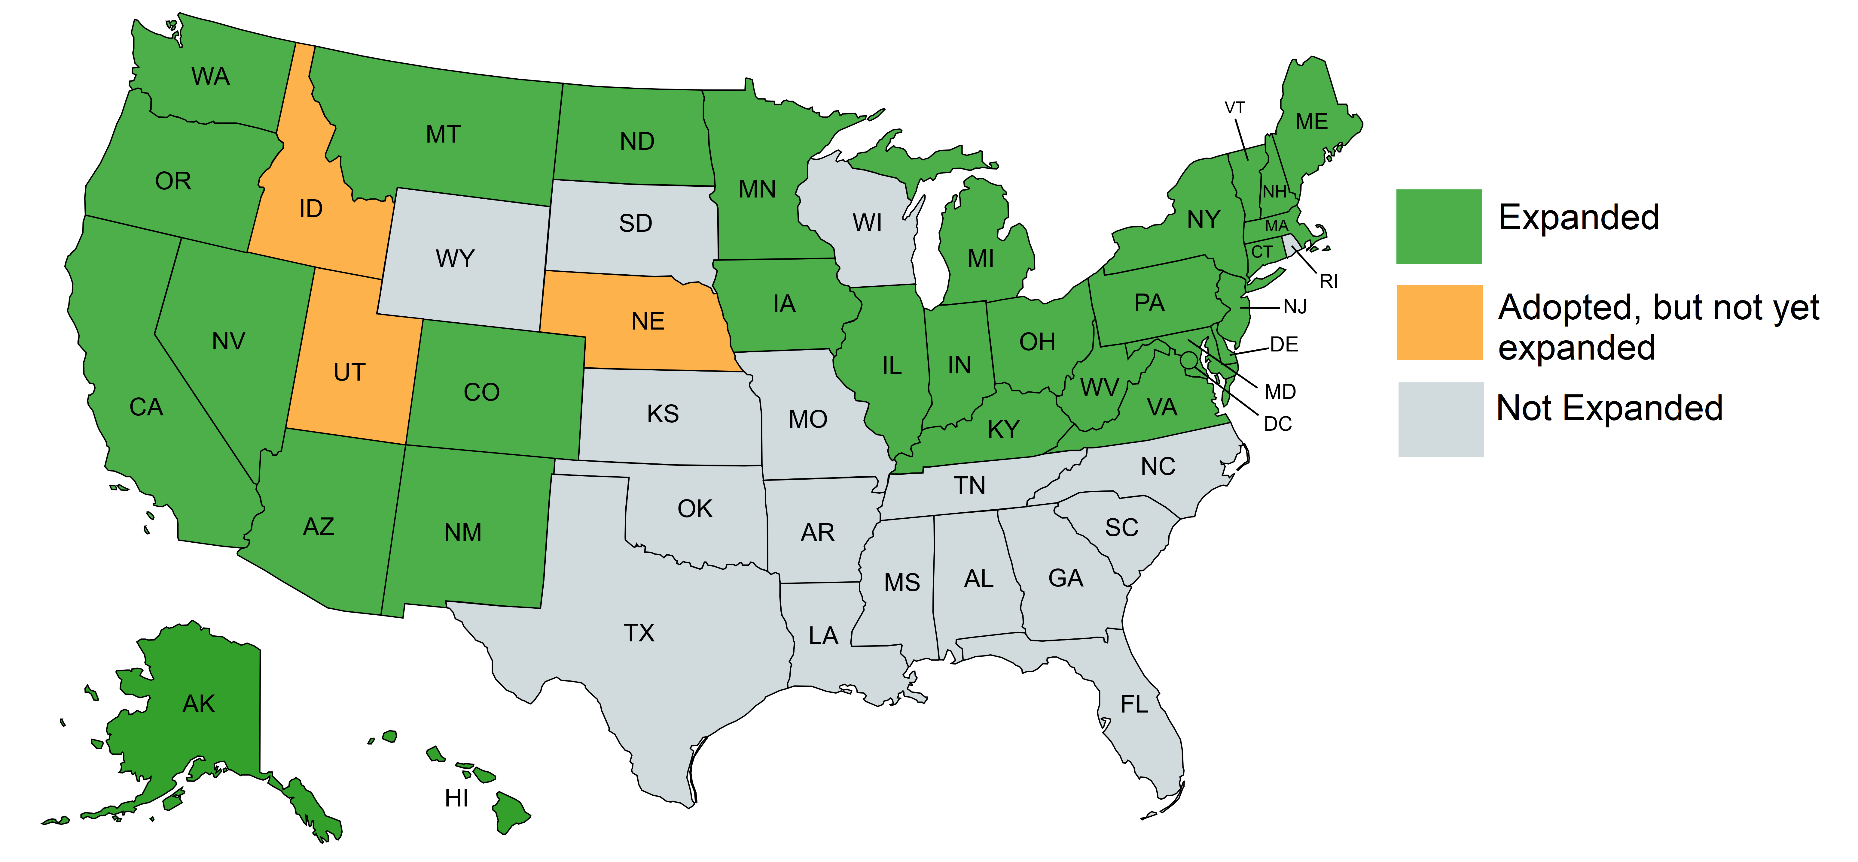
Action of Each State
This figure indicates the states which expanded Medicaid by 2019.
Idaho, Utah, and Nebraska approved expansion by 2019 but had yet to implement.
Figure 12. 2019 Medicaid Expansion Map.

Slide 27
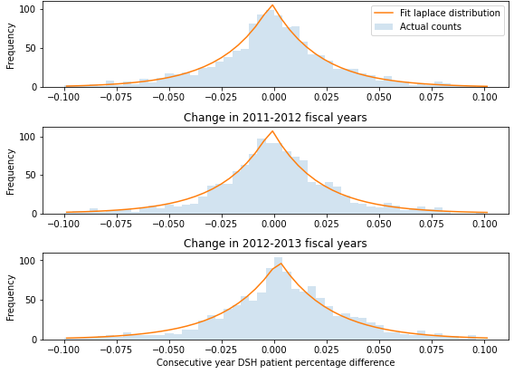
Individual Prediction of DSH Percentage
Hard to accurately predict DSH patient percentage change for individual hospitals.
Optimal prediction next year would just be the current DSH patient percentage.
Aggregate change in DSH patient percentage doesn’t follow a normal distribution.
Figure 13. DSH patient percentage differences for consecutive years.

Slide 28
Conclusions
A GUI was built to extract the raw data and summarize the cost report.
The Regression model predicts that the average percentage in 2021 will be 26.4%.
The states that did not adopt Medicaid expansion had the percentage below the national average level, which was 25.52%.
The urban hospitals show a 10% higher DSH patient percentage than the rural hospitals.

Slide 29
Recommendations
The hospitals in rural areas should be supported to meet the 15% threshold of receiving reimbursements.
Interpreting the DSH patient percentage as a random variable may be useful in for the problem of projection of DSH percentage.
Analyze how the distribution of low-income patient burden is shared by the hospitals within a market area.
Machine learning algorithms: support vector machine (SVM) and random forest (RF) can be used to analyze the demand on various branches of medicine.
Time series analysis can be utilized to determine if it would be beneficial for some hospitals to expand their outpatient care delivery.

Slide 30
Acknowledgements
\
Parker, Jesse
Mr. Jesse Parker is the Director of Reimbursement at The Rybar group. We would like to thank him for preparing the data for the project and for his approachability and flexibility. He was always available to answer all our questions and provided a deep insight into the world of medical reimbursement.
Mr. Rick Reid is the CEO of The Rybar Group. We would like to express our sincere gratitude towards him for believing in our ability and giving us this opportunity to work on the project. We would also like to thank him for providing us with his valuable support.
Ms. Brooke Yowell is a Medicaid Reimbursement Manager at The Rybar Group. We would like to thank her for her insight into future directions and for her many ideas and suggestions for our predictive modeling.
Dr. David Bramer is a professor in the Department of Mathematics at Michigan State University. We would like to thank him for his constant advice and encouragement which helped us navigate many different ideas and approaches to solve the problem statement.
Dr. Peiru Wu is a professor in the Department of Mathematics at Michigan State University and the Director of the Professional Science Master’s Program in Industrial Mathematics. We would like to sincerely express our heartfelt gratitude and appreciation to Dr. Wu for providing us with her expert guidance and counsel at each step of the project. Her invaluable feedback and useful suggestions helped us understand the intricate details of the project.
Reid, Rick
Yowell, Brooke
Bramer, David
Wu, Peiru

Slide 31


Thank you !
QUESTIONS ?

